Slide 1
FOOD SECURITY THROUGH THE WATER LENS
Anik Bhaduri
Bonn
30Th August , 2012

Slide 2
Global Water Supply and Demand
Water Scarcity - important determinant of food security than land security, according to UN ( UNDP, 2007)
Increased competition within and between sectors
Increasing costs, land degradation, water pollution, ecosystem degradation.
Irrigation - the first sector to loose out as water scarcity increases
Notes:
Irrigation is the first sector to loose out as water scarcity increases
Increasing costs of developing new water sources, land degradation in irrigated areas, water pollution, ecosystem degradation.
Water Scarcity - projected as important determinant of food security than land security, according to UN ( UNDP, 2007)

Slide 3
Challenges
Increased inequity, perpetuating poverty
Climate change
Increased risk and higher vulnerability
Notes:
Climate change hardest hit areas with intense water scarcity and food security problems are Sub Sahara Africa & parts of South Asia, which are prone to malnutrition, poverty and hunger

Slide 4
Food Security: Changed World Food Equation
Supply |  | Demand
Water Scarcity |  | Population Growth
Land Degradation |  | Income Growth
Inputs and Transport Costs |  | Poverty and Inequality
Climate Change | = | Consumer Behaviour
Farm Structure and Labor |  | Bioenergy
Technology |  | Biomass (CO2)
Less Capital (Financial Crisis)
Notes:
Water-Food systems changes are driven by demand, prices, technology and resource constraints.
Interdepnedency and feedbak effects.-Dynamic
Further complicated by trade, markets and speculation.
In short, its comlicated

Slide 5
Water Scarcity and Food Security
With continued increase in population, limits are being met on the basic resource needed to produce food
World food production is now consistently outpacing consumption
In 2008 food security came at its lowest ebb
Volatile food prices, Increasing droughts

Slide 6
Global food chain and population: Population growth linkages
Global food chain and human population growth (Khan and Hanjra, 2009

Slide 7
Water Scarcity and Food Security
Water gap will leave a food gap and affect global food security severely
Food crisis unless fundamental policy changes are made in future water use

Slide 8
World water demand to 2050
Source: de Fraiture et al., 2007;
Molden, 2007; Molden et al., 2007

Slide 9
Nexus Approaches– A web
The interconnectedness of global food and water availability, food and water security calls for joint global responsibility and cooperation
Policy- and decision-making requires a nexus approach that reduces trade-offs and builds synergies across sectors
Water-Food nexus approaches are needed to tap opportunities and avoid risks
Notes:
The amplified interconnectedness of global food and water availability, food and water security calls for joint global responsibility and cooperation
Policy- and decision-making requires a nexus approach that reduces trade-offs and builds synergies across sectors

Slide 10
Water Governance
Strengthen the human dimension of water scarcity and quality management and policy
Address land and water scarcity jointly
Intensify agricultural productivity with more efficient water use
Efficient use of water – for equitable distribution of water
Foster value oriented water reuse

Slide 11
Virtual Water Trade - Global food trade and food security linkages
Spatial scarcity can be alleviated by conveying water from where it is abundant to where it is scarce
Alternatively, by trading the product of water (crop yield) between water abundant and water scarce regions (i.e., virtual water trade)
International food trade is vital for global food security
Improve entitlements of water through exchange

Slide 12
Virtual Water Trade - Global food Trade and Food security linkages
Widen the range of food available for consumption, improving diets and satisfying food preferences
The basic approach in quantifying the virtual water trade flows so far may have been too simple to indicate whether a water scarce country is a net importer or exporter of water
In previous studies virtual water volumes are lumped together from countries experiencing vastly different degrees of water scarcity
Notes:
We incorporate water scarcity into assessments of virtual water flows.

Slide 13
Ten countries top-ranked in terms of their water use (a) and scarce-water use (b)

Slide 14
Ten countries top-ranked in terms of their water footprint (a) and scarce-water footprint (b)

Slide 15
Ten countries top-ranked in terms of their net imports of water (a) and scarce-water (b)
Lenzen and Bhaduri..et al 2012.The role of water scarcity in global virtual water flows

Slide 16
Ten countries top-ranked in terms of their net exports of water (a) and scarce-water (b)
Lenzen and Bhaduri.. et al 2012.The role of water scarcity in global virtual water flows

Slide 17
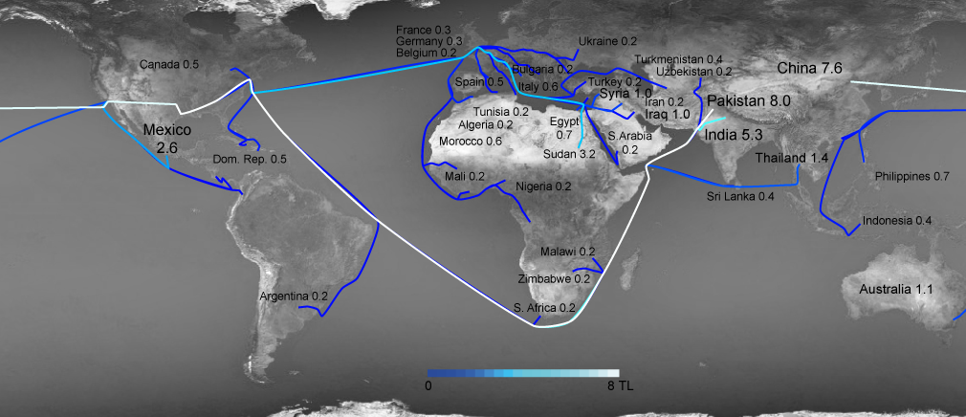
Notes:
: Top sources of virtual water imports into the USA. Flow line colour encodes the magnitude of the flow. Flow lines directly connect the original source of scarce water to American consumers; intermediate processing stops are accounted for but not explicitly visualised.
Examining the top importers of scarce water into the USA (Fig. 3), the traditional major economic trading partners in Europe, Latin America and Asia are outranked by water-scarce countries. India, Australia, China, Pakistan, Turkey, Thailand, and Argentina are major sources of scarce water embodied in imports, and suppliers in Africa (both North and Sub-Saharan) and Central Asia also stand out as exporters of scarce water. Among other water-intense agricultural products, these countries export cotton, beef, fruit, and rice. Further details can be found in SI S4.

Slide 18
Determinants of virtual water import
Per-capita imported virtual water. | Coef | t | P > t
Per-capita GDP | 0.19 | 9.73 | 0
Per-capita GDP × Per-capita water withdrawals | -0.00012 | -4.51 | 0.000
Per-capita agricultural area | 50.04 | 4.94 | 0
Water Scarcity Index | 1.45 | 3.06 | 0.003
Constant | -590.82 | -3.89 | 0.000
R² = 0.5323 | F(4,132) = 37.56
Adjusted R² = 0.5182 | Prob > F = 0.00
No. of observations: 137

Slide 19
Virtual Water Trade - Results
The results validate ( H-O theorem) that a water scarce country imports more water
Consumption of water does not necessarily mean consumption of scarce-water
Economically developed countries are the lead counties in virtual water import

Slide 20
Need more information.....
Effective tools are needed to support decision-makers in a more timely and coordinated manner in response to risks related to water and food availability

Slide 21
Role of Earth Observation
Earth observation is the basis to provide such information
from global satellite data and in-situ time series at specific locations, over tools for accessing and using the data, to systems that integrate these data with other information– especially those of food price alert systems

Slide 22
Role of Earth Observation
Significant investment is needed as sufficient infrastructure for data collection and distribution does often not exist, especially in developing countries, impeding the ability to cope with variability and change
For existing data, the challenge lies ahead to integrate earth observation and monitoring systems for agricultural commodities, and identify new metrics and valid indicators that can be applied across sectors to assess interlinkages

Slide 23
Thank you very much for your attention!

